Slide 1
Top ten improv activities
By: haley konecny

Slide 2
Improv activities?
In this powerpoint you will learn about 10 activities that have to do with improv that I have learned at Acting up! Academy of dramatic arts. These activities teach you to react and be fast and help you learn easier ways to perform in the topic of improve.

Slide 3
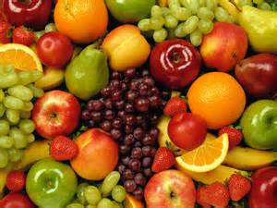
Fruit! orange, grape, apple, kiwi, kiwi, lost!
Fruit is a game where you have 12+ players and you have 1 in the middle and its like tag, but you call fruit names. First, everyone is in a circle and they all have different names (they can only be fruit names) then you start with someone in the circle and you have to act fast you say your name then you say somebody elses name before the person in the middle tags you. But if you get tagged your out and put in the middle. Also, you have to say it like this, “orange to grape” then grape would say “grape to apple” and etc, etc. this game helps the perfomer to know you have to react fast to whatever your performing to keep the story going along fast.

Slide 4
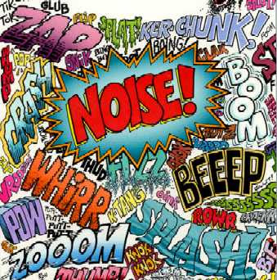
Noises.
This is a game for 6+ people and 1 person at a time comes out to the stage and makes a noise and 1 movement and you have to keep doing the same movement till the last person comes out and has done their movement and noise at least 3 times. So it will go like this 1 person walks out and they start hammering and at the same time they make a noise like bam! So it looks and sounds like they are hammering into a piece of wood and then somebody else comes out and they add to it so this person would come out to the side of the person and then act as if they are picking up wood and make a sound like when they pick it up they can make a swoosh noise

Slide 5
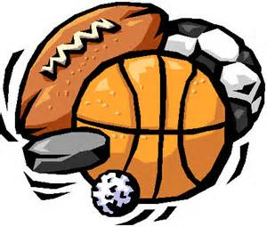
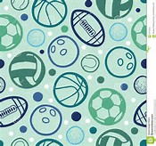
What game? Baseball, hockey or basketball?
This game you have about 10+ people and you split into 2 teams and you have to decide what sport your gonna play and you keep playing for about 10 minutes or so. This game teaches you that in improv its not just about you and you having to figure out what to do you also have to know you have to have everyone participating and include everyone or its not gonna work out well.

Slide 6
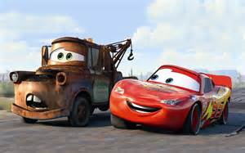
Cars! Vroom, vroom, reverse, vroom, forward!
Cars is a game for 6+ people and you stand in a circle and I person says vroom while making a motion towards some on their left or right and you keep going till someone is out, and that is when a person says vroom to slow or they redirect it to the person that it came from.

Slide 7
Character swap
2 players improvise a scene, and make distinct strong physical and vocal choices. The scene is played until we get a good description of the characters. Then the roles are reversed, and every player plays the other character in the exact same scene and location. This activities trains both performers to listening and physical observation.

Slide 8
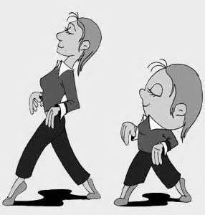
Copy cat
This is a game where you can have multiple players. You take one person and start a random song from your ipod and that person has to start dancing while the other players copy them. Then the director/teacher will call out another players name and then they will have to dance to another song. This teaches all players to be on time, to observe and to act.

Slide 9
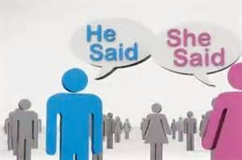
He said she said
This is a 2 person game where 1 performer says out a line while acting out something that’s completely opposite to what they are saying. After player 1 has speaked and they are still acting out a movement performer 2 narrates what performer 1 is doing. This helps the performers listen and notice every little thing a performer is doing to help better their scene.

Slide 10
Freeze and framed
This consist of all performers participating in the improve classes. One player goes out and freezes into a position, then another player goes out and adds on to that players position and it keeps going till the last player and the last player says freeze. This helps the performer to act fast and be prepared for any scene or role.

Slide 11
Genre that scene.
This is where 4 performers are acting out a scene, but they do not talk. They only move and mouth words and have extreme emotion in their face and body language. They act out to music. Mainly instrumental music with an easy genre to be noticed. And the performers keep going till the song ends and this helps the performers to know how to set an mood and to keep a characters emotion flexible.

Slide 12
Past. Present. Future.
This is where 1 performer is onstage and the director calls out to someone in the audience to give the performer an location, description of a character, and conflict. So the performer must act out something before conflict happens, act out during conflict and act out after conflict. While the character is acting before, during and after conflict the performer must act out to the audience where character is, and description about the character. This helps keep the character on track with a story and basically helps build a climax to conflict.

Slide 13
Refrences
“The Thespis in the rest of us” by Kevin L. Meir.

